Slide 1
COMP 4500
Week 13 - Wednesday

Slide 2
Last time
What did we talk about last time?
A little bit about computability
Approximation algorithms
Started load balancing

Slide 3
Questions?

Slide 4
Assignment 7

Slide 5
Logical warmup
A sociologist named McSnurd gave a talk about a community that has clubs with the following attributes:
  A person can belong to more than one club
  Each club is named after a person
  No two different clubs are named after the same person
  Every person has a club named after him or her
  A person may or may not belong to the club named after them
    If they do, that person is called sociable
    If they don't, that person is called unsociable
  Perhaps surprisingly, there is a club whose entire membership is made up of all of the unsociable people
Do you believe McSnurd's description?

Slide 6
Revenge of the logical warmup
Another sociologist named McSnuff described a similar community:
  As before, there is the same number of clubs as people, and each club is named after exactly one person
  However, a person can be a member of a club openly or secretly
    If a person is not openly a member of the club named after them, they are suspicious
    If a person is secretly a member of the club named after them, they are a spy
  Perhaps surprisingly, there is a club whose entire membership is made up of all the suspicious people
Do you believe McSnuff's description?
Do you know whether or not there is at least one spy in the community?

Slide 7
Load Balancing

Slide 8
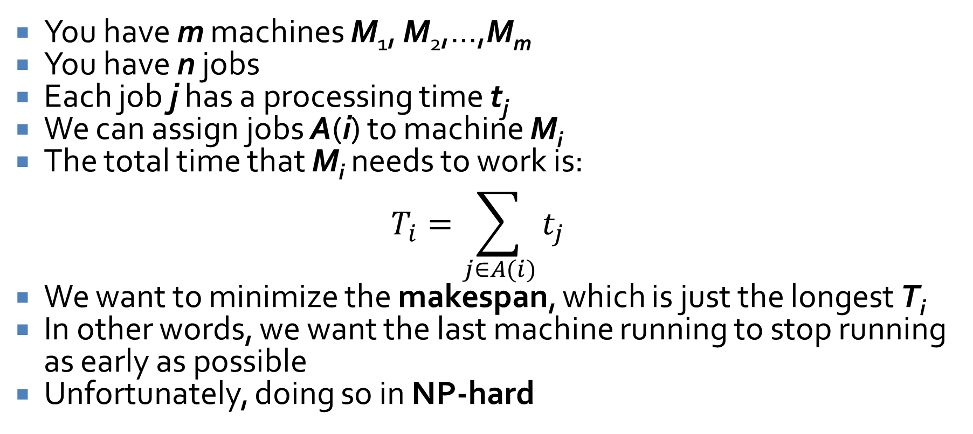
Load balancing
You have m machines M₁, M₂,…,M_{m}
You have n jobs
Each job j has a processing time t_{j}
We can assign jobs A(i) to machine M_{i}
The total time that M_{i} needs to work is:
$$T_{i}=\sum_{j∈A(i)}{t_{j}}$$
We want to minimize the makespan, which is just the longest T_{i}
In other words, we want the last machine running to stop running as early as possible
Unfortunately, doing so in NP-hard

Slide 9
Greedy algorithm
We can use a simple greedy algorithm for assigning jobs:
  For each job j, assign it to the machine that has the shortest completion time so far

Slide 10
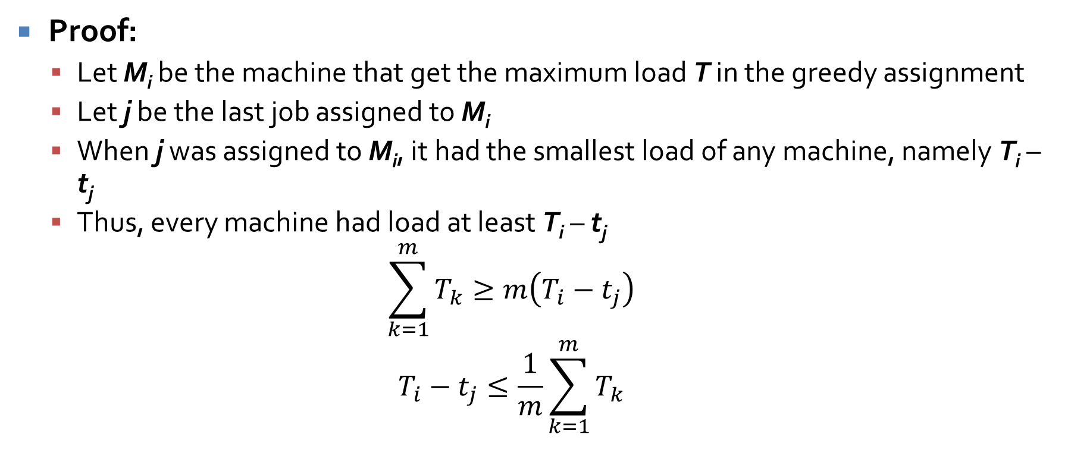
Greedy algorithm gets a makespan T ≤ 2T*
Proof:
  Let M_{i} be the machine that get the maximum load T in the greedy assignment
  Let j be the last job assigned to M_{i}
  When j was assigned to M_{i}, it had the smallest load of any machine, namely T_{i} – t_{j}
  Thus, every machine had load at least T_{i} – t_{j}
  $$\sum_{k=1}^{m}{T_{k}}≥m\left(T_{i}−t_{j}\right)$$
  $$T_{i}−t_{j}≤\frac{1}{m}\sum_{k=1}^{m}{T_{k}}$$

Slide 11
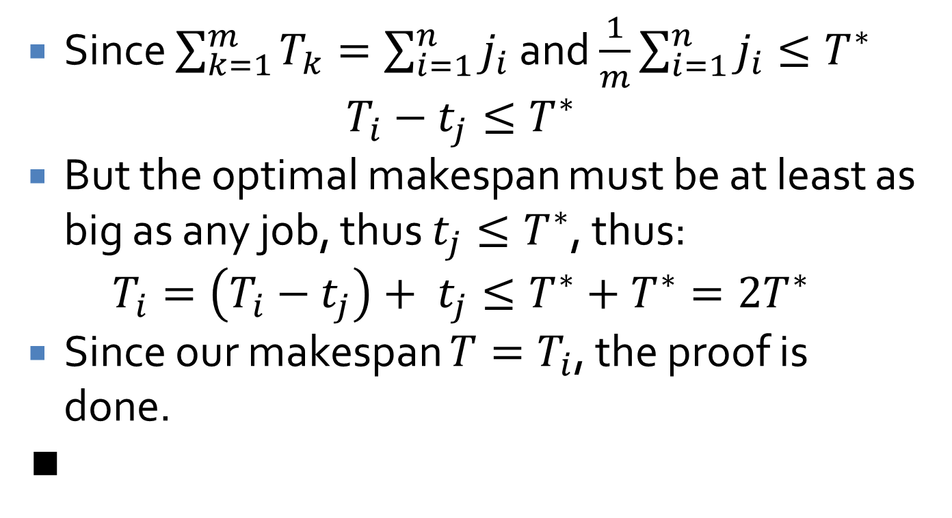
Proof continued
Since $\sum_{k=1}^{m}{T_{k}}=\sum_{i=1}^{n}{j_{i}}$ and $\frac{1}{m}\sum_{i=1}^{n}{j_{i}}≤T^{∗}$
$$T_{i}−t_{j}≤T^{∗}$$
But the optimal makespan must be at least as big as any job, thus $t_{j}≤T^{∗}$, thus:
$$T_{i}=\left(T_{i}−t_{j}\right)+ t_{j}≤T^{∗}+T^{∗}=2T^{∗}$$
Since our makespan $T=T_{i}$, the proof is done.
∎

Slide 12
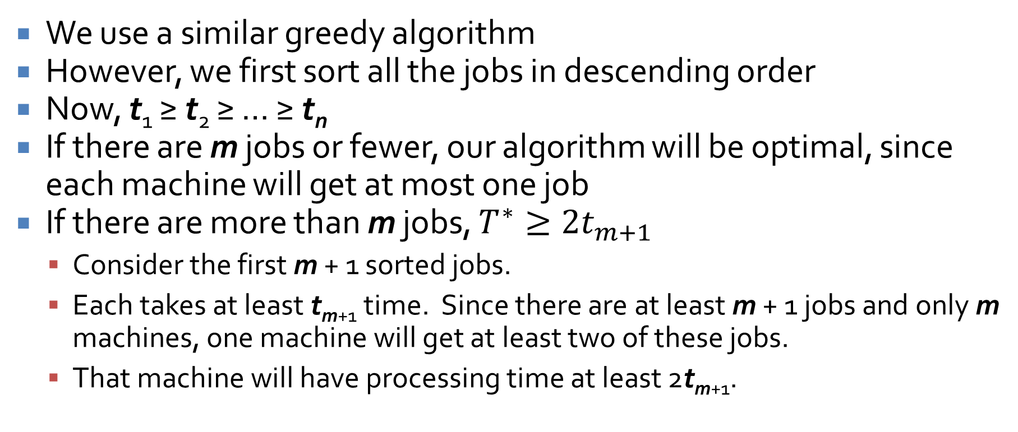
Improved approximation algorithm
We use a similar greedy algorithm
However, we first sort all the jobs in descending order
Now, t₁ ≥ t₂ ≥ … ≥ t_{n}
If there are m jobs or fewer, our algorithm will be optimal, since each machine will get at most one job
If there are more than m jobs, $T^{∗}≥2t_{m+1}$
  Consider the first m + 1 sorted jobs.
  Each takes at least t_{m+1} time. Since there are at least m + 1 jobs and only m machines, one machine will get at least two of these jobs.
  That machine will have processing time at least 2t_{m+1}.

Slide 13
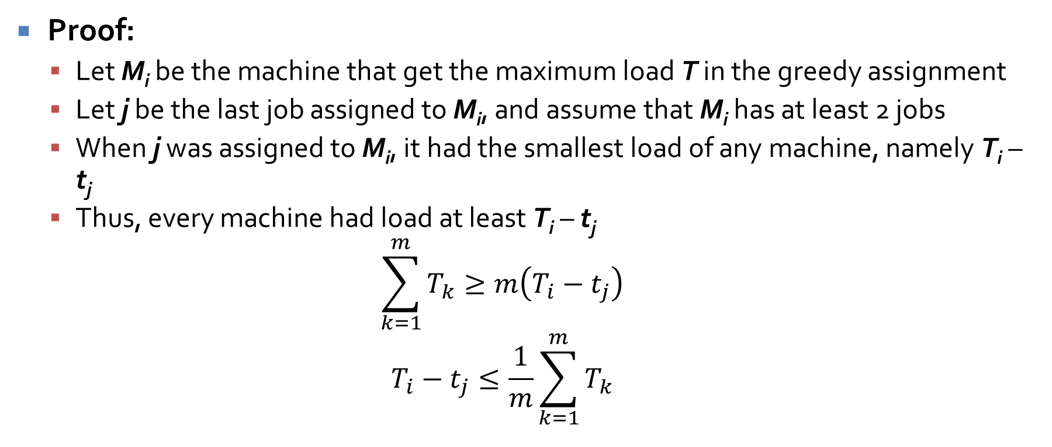
Sorted greedy algorithm gets a makespan T ≤ $\frac{3}{2}$T*
Proof:
  Let M_{i} be the machine that get the maximum load T in the greedy assignment
  Let j be the last job assigned to M_{i}, and assume that M_{i} has at least 2 jobs
  When j was assigned to M_{i}, it had the smallest load of any machine, namely T_{i} – t_{j}
  Thus, every machine had load at least T_{i} – t_{j}
  $$\sum_{k=1}^{m}{T_{k}}≥m\left(T_{i}−t_{j}\right)$$
  $$T_{i}−t_{j}≤\frac{1}{m}\sum_{k=1}^{m}{T_{k}}$$

Slide 14
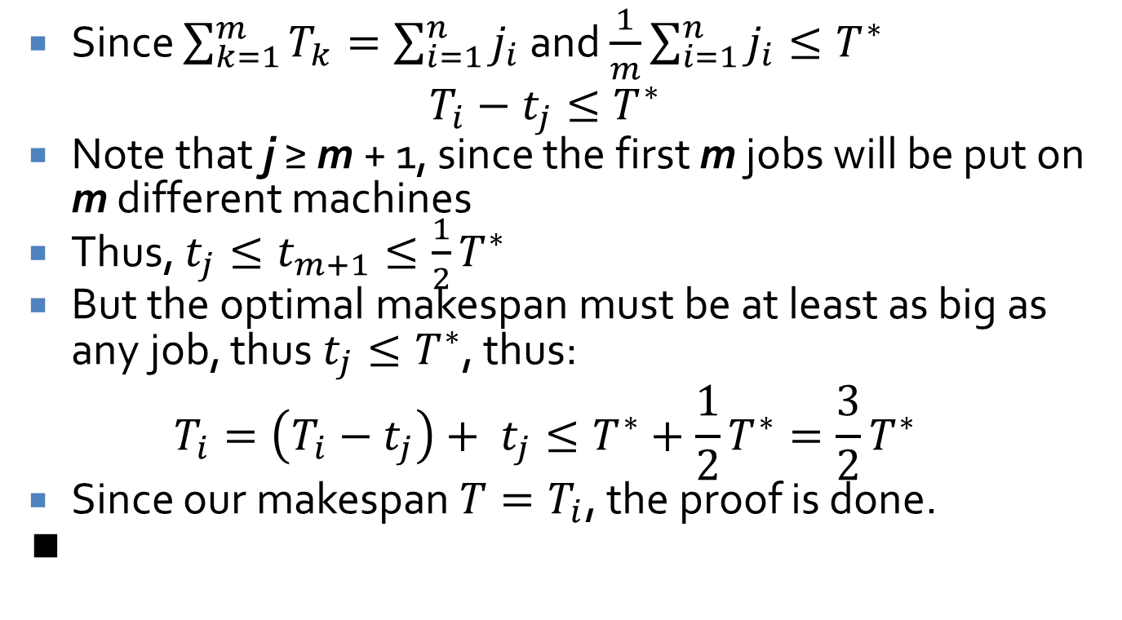
Proof continued
Since $\sum_{k=1}^{m}{T_{k}}=\sum_{i=1}^{n}{j_{i}}$ and $\frac{1}{m}\sum_{i=1}^{n}{j_{i}}≤T^{∗}$
$$T_{i}−t_{j}≤T^{∗}$$
Note that j ≥ m + 1, since the first m jobs will be put on m different machines
Thus, $t_{j}≤t_{m+1}≤\frac{1}{2}T^{∗}$
But the optimal makespan must be at least as big as any job, thus $t_{j}≤T^{∗}$, thus:
$$T_{i}=\left(T_{i}−t_{j}\right)+ t_{j}≤T^{∗}+\frac{1}{2}T^{∗}=\frac{3}{2}T^{∗}$$
Since our makespan $T=T_{i}$, the proof is done.
∎

Slide 15
Center Selection
We have a set S of n sites, like towns
We want to build k centers, like Starbucks
We want to minimize the distance from a site to its closest facility, called the covering radius
Distances obey the following rules:
  d(s, s) = 0
  d(u, v) = d(v, u)
  d(x, y) + d(y, z) ≥ d(x, z)

Slide 16
Bad greedy algorithm
Put one facility in the middle of all the cities
Keep adding centers to reduce the worst outlier
First, it's not clear how to pick later centers
Second, we can show that this could be arbitrarily bad with 2 cities and 2 centers
  First Starbucks would go right between the two cities
  Second one would go…where?
  Obviously, the best locations would be right on top of the cities

Slide 17
Insight for better greedy algorithm
Imagine that we knew that the maximum radius of cover was r
We could use this knowledge to get a covering radius of no more than 2r
Algorithm:
  Pick any city, put a Starbucks there
  Remove any cities within 2r of the city
  Keep going as long as there are cities in the set

Slide 18
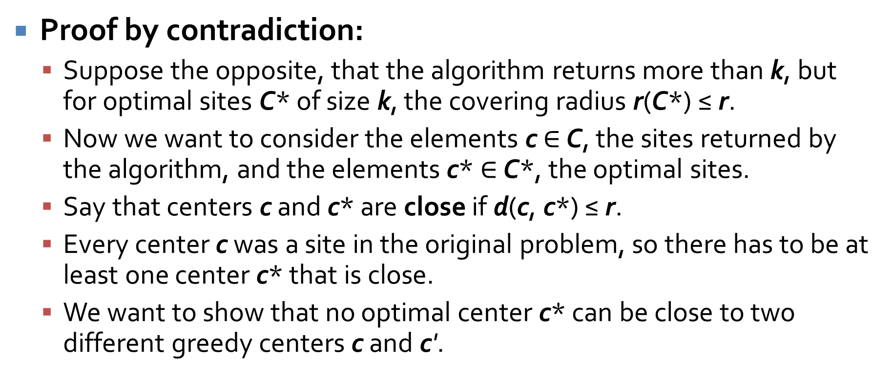
If more than k centers are returned, the best covering radius > r
Proof by contradiction:
  Suppose the opposite, that the algorithm returns more than k, but for optimal sites C* of size k, the covering radius r(C*) ≤ r.
  Now we want to consider the elements c $∈$ C, the sites returned by the algorithm, and the elements c* $∈$ C*, the optimal sites.
  Say that centers c and c* are close if d(c, c*) ≤ r.
  Every center c was a site in the original problem, so there has to be at least one center c* that is close.
  We want to show that no optimal center c* can be close to two different greedy centers c and c'.

Slide 19
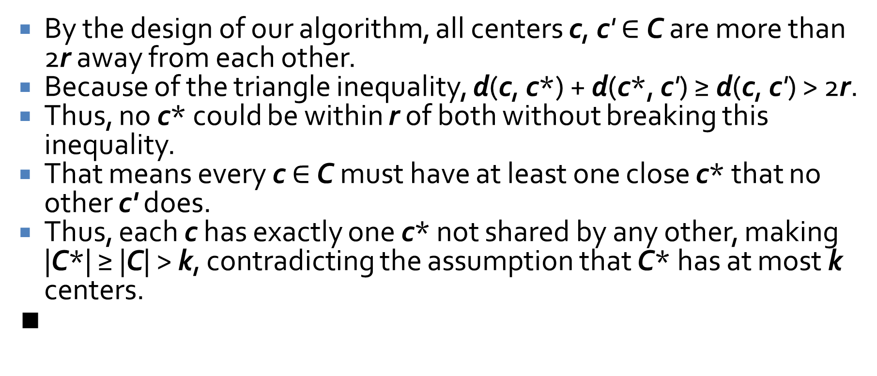
Proof continued
By the design of our algorithm, all centers c, c' $∈$ C are more than 2r away from each other.
Because of the triangle inequality, d(c, c*) + d(c*, c') ≥ d(c, c') > 2r.
Thus, no c* could be within r of both without breaking this inequality.
That means every c $∈$ C must have at least one close c* that no other c' does.
Thus, each c has exactly one c* not shared by any other, making |C*| ≥ |C| > k, contradicting the assumption that C* has at most k centers.
∎

Slide 20
Without knowing r
We know that r > 0 and r is less than or equal to maximum distance between any two sites
  We could binary search between those two values
Instead, our algorithm that magically knew r only used it to pick sites 2r or further from existing centers
So…all we really need to do is pick sites that are far away from our existing centers

Slide 21
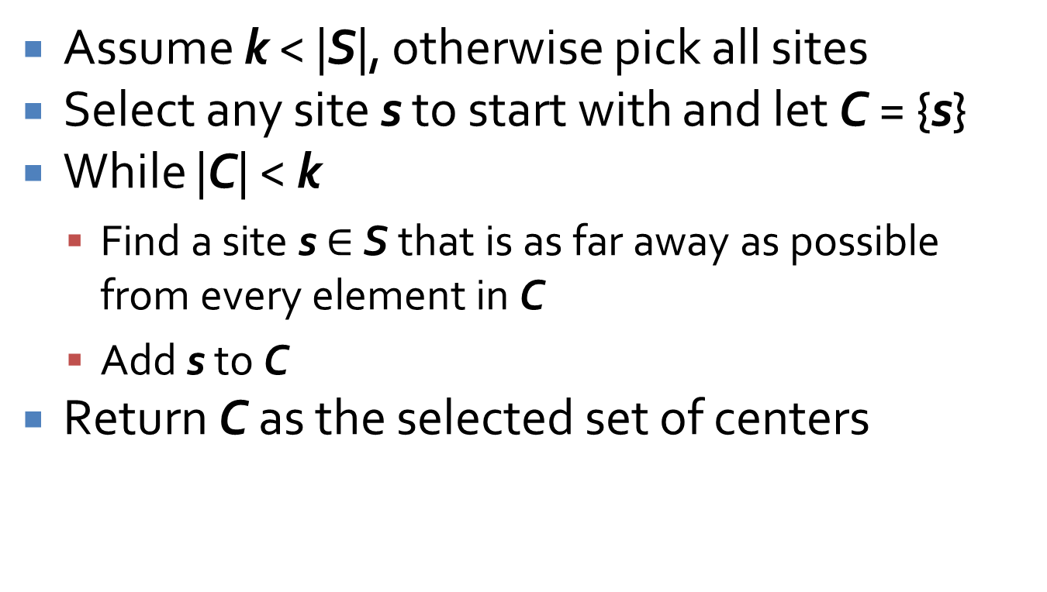
Updated greedy algorithm
Assume k < |S|, otherwise pick all sites
Select any site s to start with and let C = {s}
While |C| < k
  Find a site s $∈$ S that is as far away as possible from every element in C
  Add s to C
Return C as the selected set of centers

Slide 22
Proof of approximation bound
Claim:
  Our new greedy algorithm returns a set C of k points such that r(C) ≤ 2r(C*) where C* is an optimal set of k points.
Proof by contradiction:
  Assume we got a set C with k centers such that r(C) > 2r.
  There is some site s that is more than 2r from every center in C.
  At some point in the algorithm, we have only selected centers C'.
  We are just about to add center c'.

Slide 23
Proof continued
We claim that c' is at least 2r away from all sites in C' because of this inequality:
  d(c', C') ≥ d(s, C') ≥ d(s, C) > 2r
So our greedy algorithm follows the first k iterations of the algorithm that knew r since it always picks a center more than 2r from previously selected centers.
But we proved that algorithm would only pick more than k centers if the optimal k centers did not have a covering radius of r.
By the same contradiction, no site s can be further than 2r from a center, so r(C) ≤ 2r.
∎

Slide 24
Three Sentence Summary of Set Cover

Slide 25
Set cover (optimization version)
Given:
  Set U of n elements
  Collection of sets S₁, S₂,…, S_{m} of subsets of U
  Each subset S_{i} has a weight w_{i} ≥ 0
Find the subsets with smallest total weight whose union is equal to all of U

Slide 26
Algorithm design
We want the most bang for our buck
We want small weight sets with a lot of elements
  In other words, low cost per element
So, we look at the value w_{i}/|S_{i}| for each set, and pick the lowest such value set
We keep doing that, but we only "count" the elements in each set that still aren't covered

Slide 27
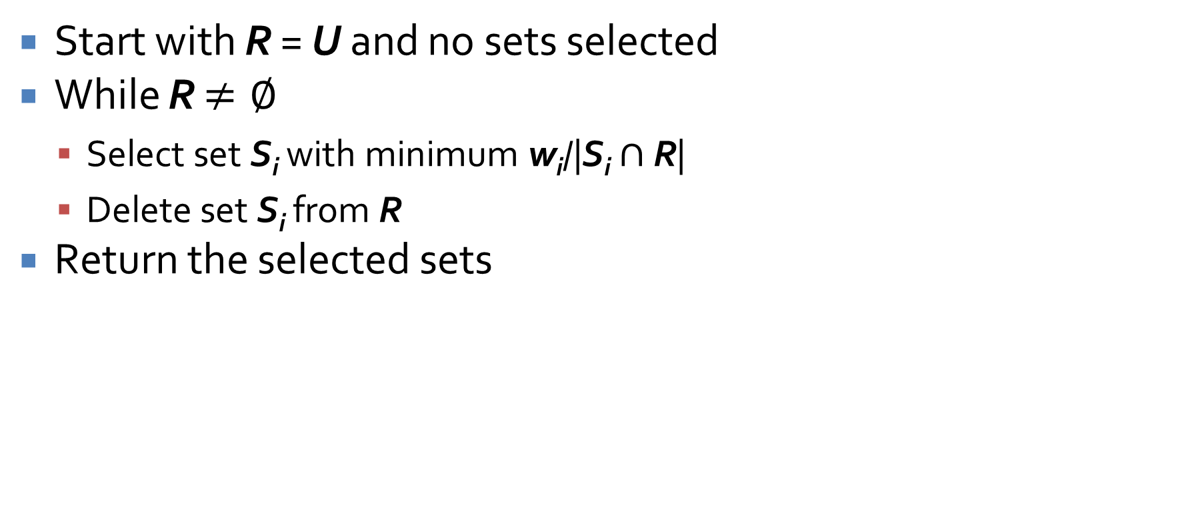
Greedy set cover algorithm
Start with R = U and no sets selected
While R $≠∅$
  Select set S_{i} with minimum w_{i}/|S_{i} $∩$ R|
  Delete set S_{i} from R
Return the selected sets

Slide 28
Set cover example
1 + ε
1 + ε
Algorithm finds a total weight of 4
1
1
1
Optimal is a total weight of 2 + 2ε
1

Slide 29
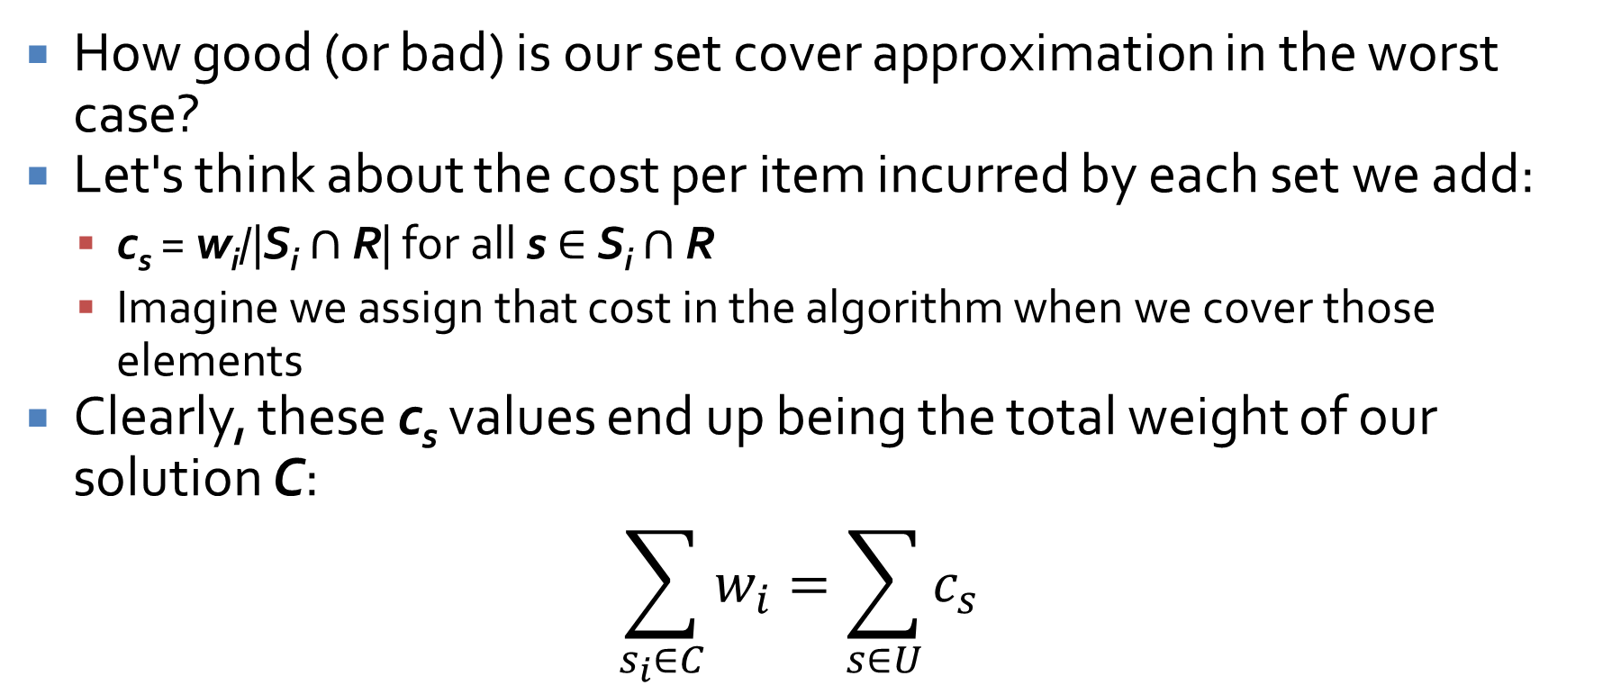
Analysis
How good (or bad) is our set cover approximation in the worst case?
Let's think about the cost per item incurred by each set we add:
  c_{s} = w_{i}/|S_{i} $∩$ R| for all s $∈$ S_{i} $∩$ R
  Imagine we assign that cost in the algorithm when we cover those elements
Clearly, these c_{s} values end up being the total weight of our solution C:
$$\sum_{s_{i}∈C}{w_{i}}=\sum_{s∈U}{c_{s}}$$

Slide 30
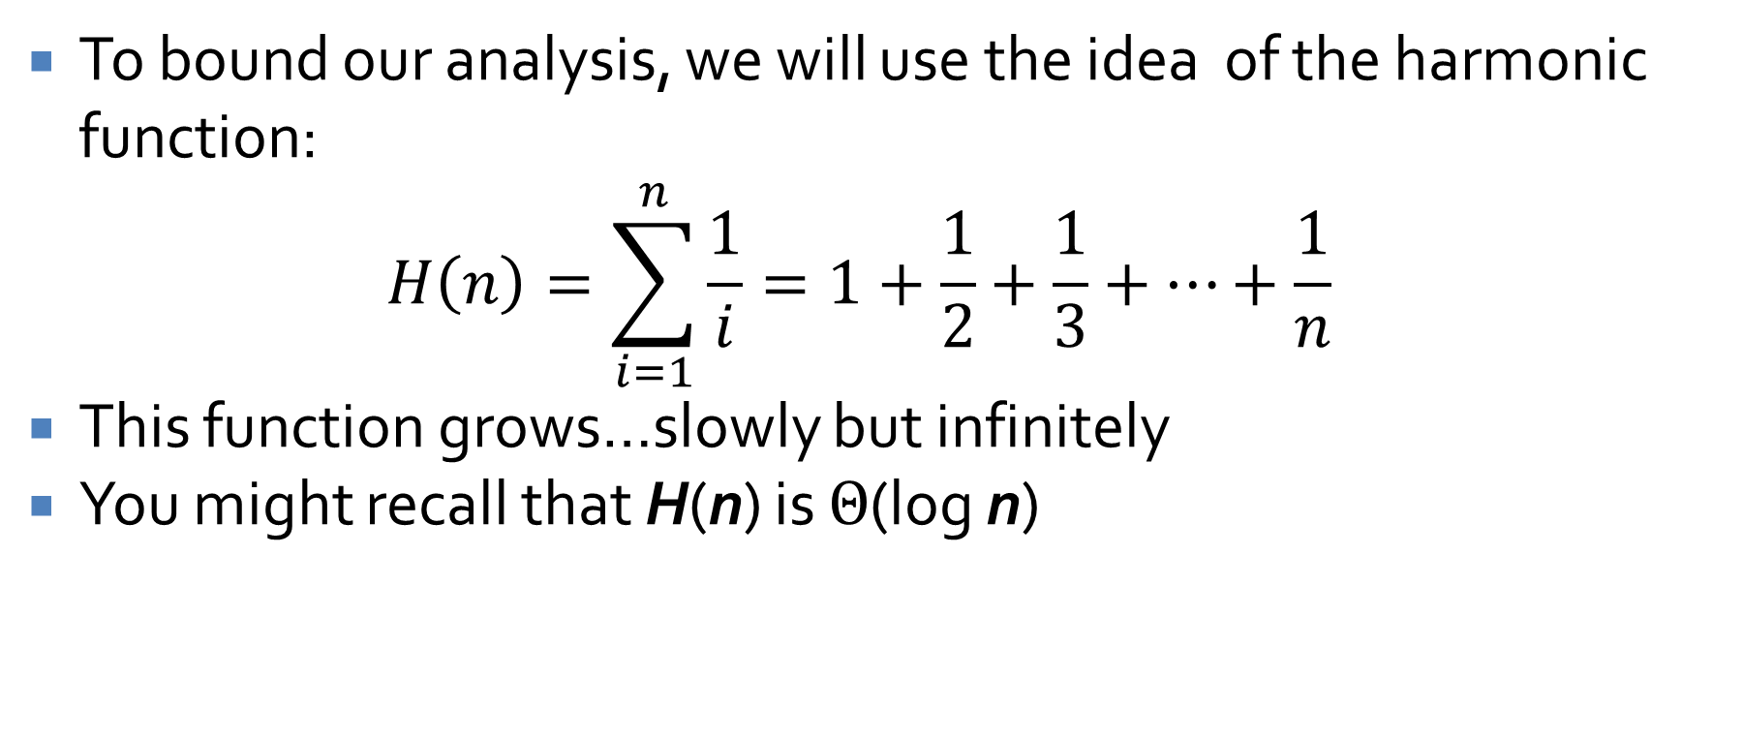
Unfortunately: math
To bound our analysis, we will use the idea of the harmonic function:
$$H\left(n\right)=\sum_{i=1}^{n}{\frac{1}{i}}=1+\frac{1}{2}+\frac{1}{3}+…+\frac{1}{n}$$
This function grows…slowly but infinitely
You might recall that H(n) is $Θ$(log n)

Slide 31
Bound on each set
Claim:
  For every set S_{k}, $\sum_{s∈S_{k}}{c_{s}}$ is at most H(|S_{k}|)w_{k}
Proof:
  For notation, assume |S_{k}| = d, and S_{k} = the first d elements of U
  In other words, S_{k} = {s₁, s₂, …, s_{d}}
  Even better, let's assume the elements are labeled in the order that they are assigned a cost $c_{s_{j}}$

Slide 32
Proof continued
Consider the iteration when s_{j} is covered by our algorithm, for some j ≤ d.
Before this iteration, s_{j}, s_{j+1},…,s_{d} $∈$ R
This implies that |S_{k} $∩$ R| is at least d – j + 1, making the average cost of set S_{k} at most
$$\frac{w_{k}}{|S_{k}∩R|}≤\frac{w_{k}}{d−j+1}$$
On this particular iteration, the greedy algorithm selects a set S_{i} of minimum average cost
  Thus, S_{i} has an average cost no more than S_{k}

Slide 33
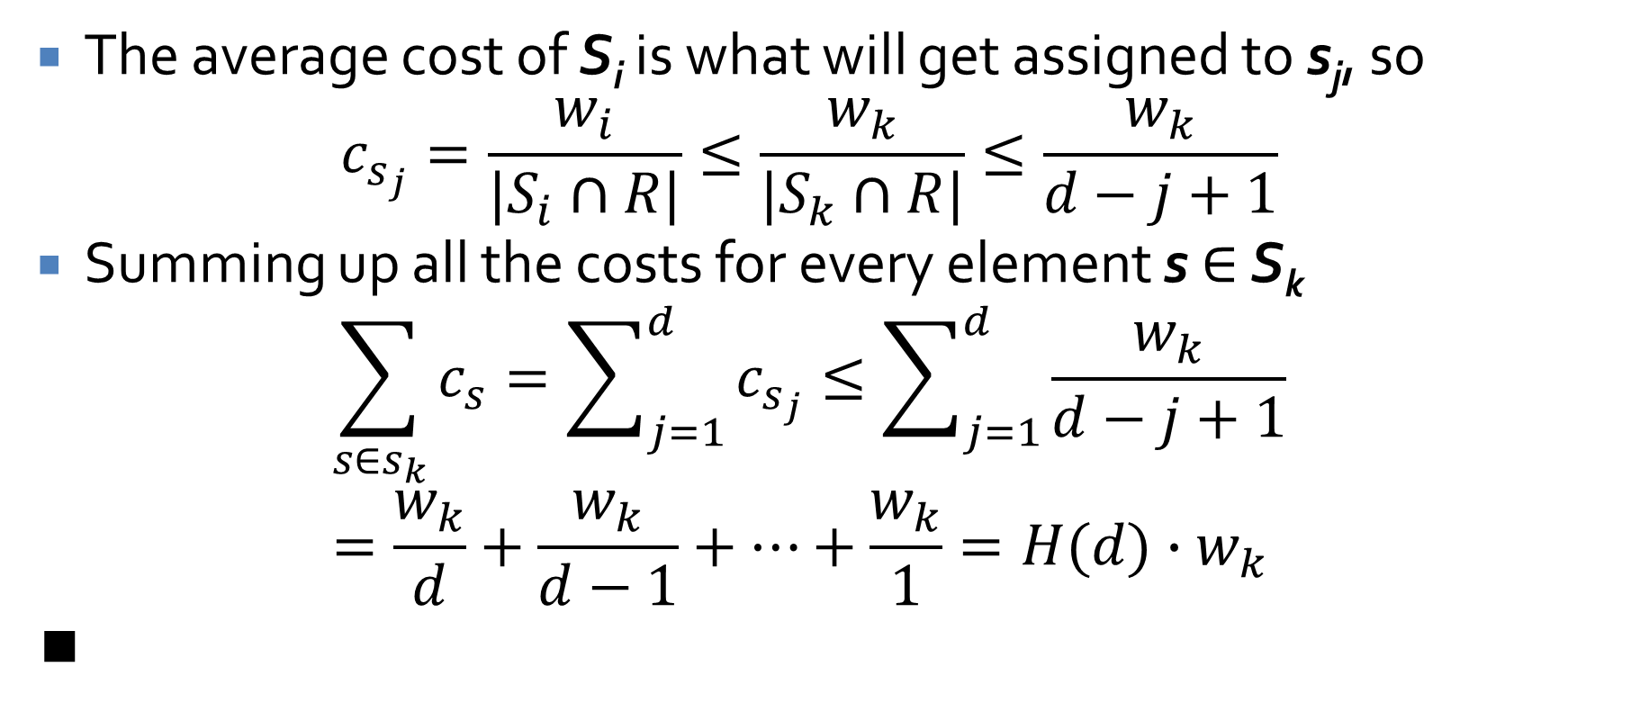
Proof continued
The average cost of S_{i} is what will get assigned to s_{j}, so
$$c_{s_{j}}=\frac{w_{i}}{|S_{i}∩R|}≤\frac{w_{k}}{|S_{k}∩R|}≤\frac{w_{k}}{d−j+1}$$
Summing up all the costs for every element s $∈$ S_{k}
$$\sum_{s∈s_{k}}{c_{s}=\sum_{j=1}^{d}{c_{s_{j}}}}≤\sum_{j=1}^{d}{\frac{w_{k}}{d−j+1}}=\frac{w_{k}}{d}+\frac{w_{k}}{d−1}+…+\frac{w_{k}}{1}=H(d)∙w_{k}$$
∎

Slide 34
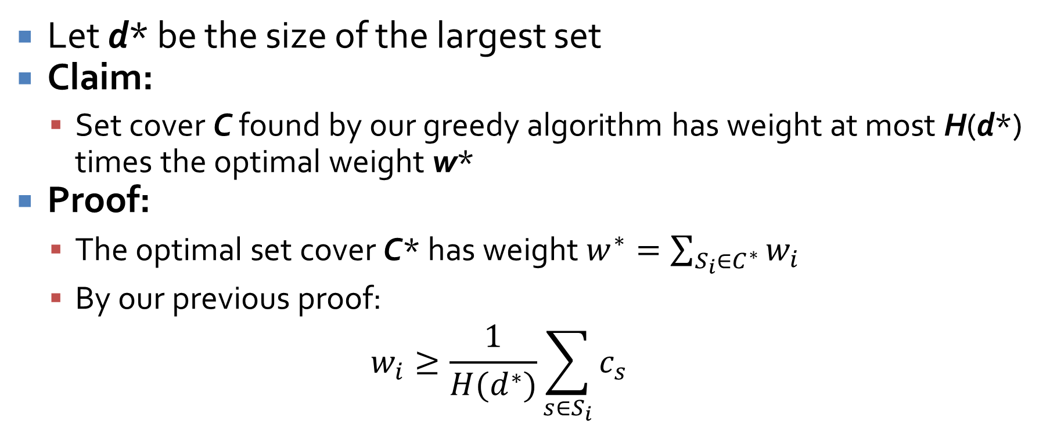
Final approximation bound
Let d* be the size of the largest set
Claim:
  Set cover C found by our greedy algorithm has weight at most H(d*) times the optimal weight w*
Proof:
  The optimal set cover C* has weight $w^{∗}=\sum_{S_{i}∈C^{∗}}{w_{i}}$
  By our previous proof:
  $$w_{i}≥\frac{1}{H(d^{∗})}\sum_{s∈S_{i}}{c_{s}}$$

Slide 35
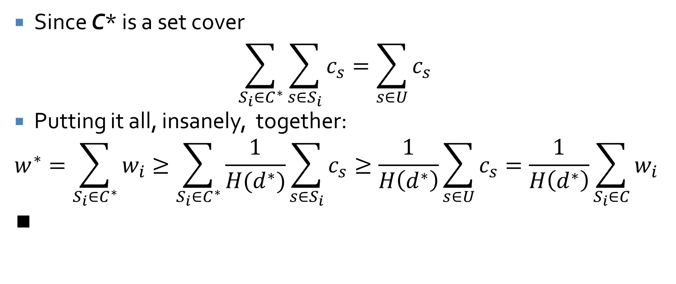
Approximation bound continued
Since C* is a set cover
$$\sum_{S_{i}∈C^{∗}}{\sum_{s∈S_{i}}{c_{s}}}=\sum_{s∈U}{c_{s}}$$
Putting it all, insanely, together:
$$w^{∗}=\sum_{S_{i}∈C^{∗}}{w_{i}≥\sum_{S_{i}∈C^{∗}}{\frac{1}{H(d^{∗})}\sum_{s∈S_{i}}{c_{s}}}}≥\frac{1}{H\left(d^{∗}\right)}\sum_{s∈U}{c_{s}}=\frac{1}{H\left(d^{∗}\right)}\sum_{S_{i}∈C}{w_{i}}$$
∎

Slide 36
Log approximation
All of that madness means that our approximation algorithm to set cover might return a set cover costing O(log d*) times the true optimal
Worse, d* could be some constant fraction of n, making the approximation an O(log n) times worse than optimal
This approximation is worse than any constant approximation, since our approximation actually will degrade as n gets larger
To top it off, there's even a proof that this is the best you can approximate set cover, unless P = NP

Slide 37
Upcoming

Slide 38
Next time…
Approximating knapsack
Read section 11.8

Slide 39
Reminders
Work on Assignment 7
  Due the last day of class

